Slide 1
Project - Pitches
Caroline Percy & Danial Nor Azman

Slide 2
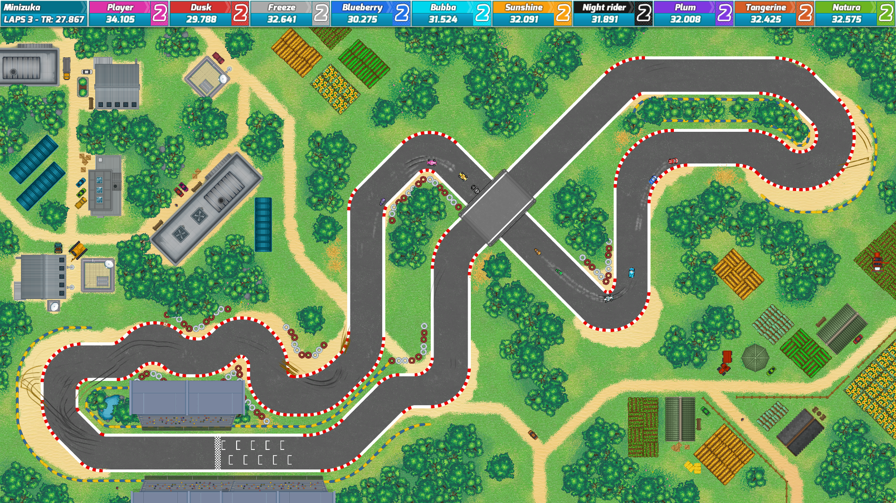

#1: Racing Car Game
Top-Down 2D racing game.
The AI will avoid the player while still trying to finish the race using pathfinding
The player and the AI will have power ups that they can use
There will be some hidden shortcuts (scope up)
Different car choices(scope up)
Local multiplayer (scope up)

Slide 3
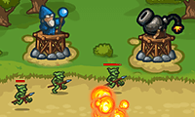
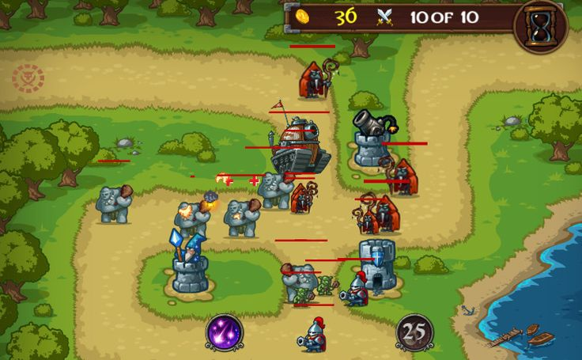
#2: Tower Defense Game
This one is a tower Defense Game with several levels. Variety on enemies and towers.
Small, fast enemies vs big, slow ones.
Enemies would pathfind the way to the goal.
Each level could have a random pathway to the goal (scope up).
Towers will be upgradable and powers can be bought from money dropped from enemies (scope up)

Slide 4
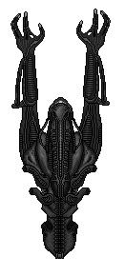
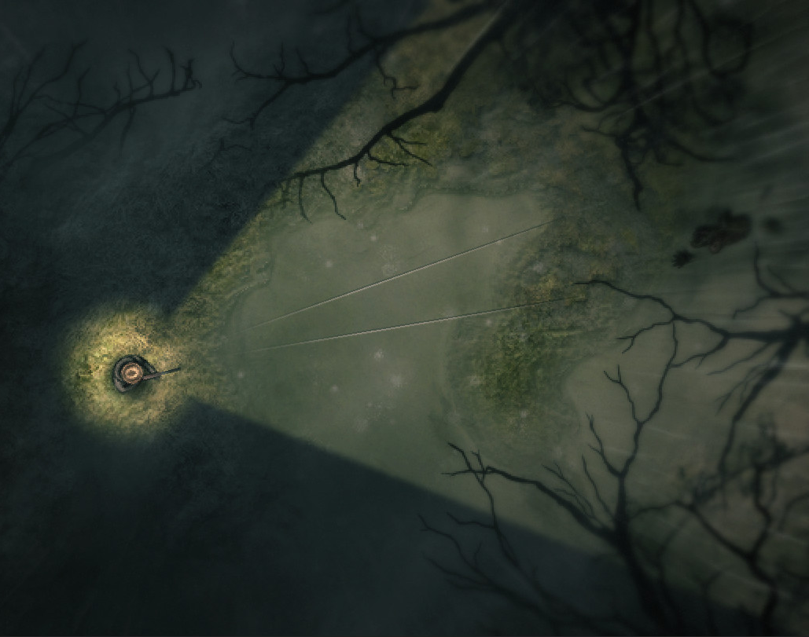
Top-down Horror game
The Alien will be patrolling around using pathfinding to different areas.
It’s pathfinding can change to a different location if the player make some noise, Ex. player opening a door.
Will track player using pathfinding if player is found. (Or hides too long (scope up))
Player can hide or lose the alien using 1-time use items. (scope up)
Large ship to navigate and escape from (scope up)

Slide 5
Thank you for listening!

